Slide 1
Insurance Purchase Prediction Using Customer Data:
G Srivaishnavi
Batch no:MDTE04

Slide 2
PROBLEM STATEMENT:
A new-age insurance company employs multiple outreach plans to sell term insurance to its customers. Telephonic marketing campaigns remain one of the most effective ways to reach potential clients, however these campaigns incur significant costs. To optimize resources and reduce expenses, it is crucial to identify the customers who are most likely to convert beforehand so that they can be specifically targeted via calls. Given historical marketing data, the objective is to build a machine learning model that will predict if a client will subscribe to the insurance.

Slide 3
ANALYZING DATASET:
The dataset comprises 11 columns, including 10 features and 1 target variable. Below is a detailed explanation of each column:
Features:
Age: Type: Numeric
Description: Represents the age of the client. This is an important demographic feature that can influence the likelihood of a client subscribing to insurance. For instance, certain age groups may be more inclined to purchase insurance due to their stage in life or financial planning needs.
Job: Type: Categorical
Description: Indicates the type of job the client has. Examples include "admin", "blue-collar", "entrepreneur", etc. The type of occupation can reflect the client's income level, job stability, and potential interest in insurance products.
Marital: Type: Categorical
Description: Shows the marital status of the client. Common categories are "single", "married", and "divorced". Marital status can influence financial decisions and priorities, impacting the likelihood of subscribing to insurance.
Educational_qual: Type: Categorical
Description: Reflects the education level of the client, such as "primary", "secondary", "tertiary", etc. Education can affect a client's understanding of insurance benefits and their financial literacy.
Call_type: Type: Categorical
Description: Type of communication used to contact the client. Categories may include "cellular", "telephone", etc. The mode of communication can impact the effectiveness of the outreach and the client's responsiveness.

Slide 4
Day: Type: Numeric
Description: The day of the month when the last contact was made. This can capture time-specific patterns in client behavior or responsiveness.
Mon: Type: Categorical
Description: The month of the year when the last contact was made. Examples are "jan", "feb", "mar", etc. Seasonality can affect client decisions and their availability.
dur: Type: Numeric
Description: Duration of the last contact in seconds. Longer call durations may indicate more engaged conversations, which could correlate with a higher likelihood of conversion.
Num_calls: Type: Numeric
1.Description: Number of contacts made with the client during the current campaign. This feature captures the persistence of the outreach efforts and the client's responsiveness.
Prev_outcome: Type: Categorical
Description: Outcome of the previous marketing campaign for this client. Categories include "unknown", "other", "failure", and "success". Past behavior can be a strong predictor of future actions, with previous success indicating a higher likelihood of future conversion.
Output Variable (Desired Target):
Y:
Type: Binary
Description: Indicates whether the client has subscribed to the insurance (1 for yes, 0 for no). This is the target variable that the model will predict, based on the provided features.

Slide 5
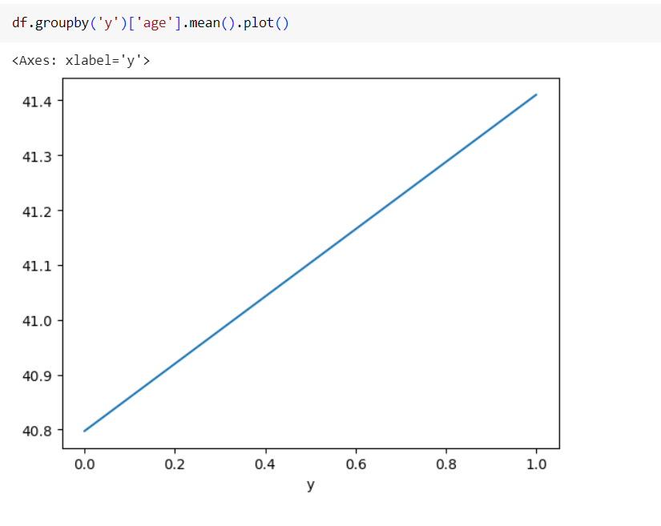
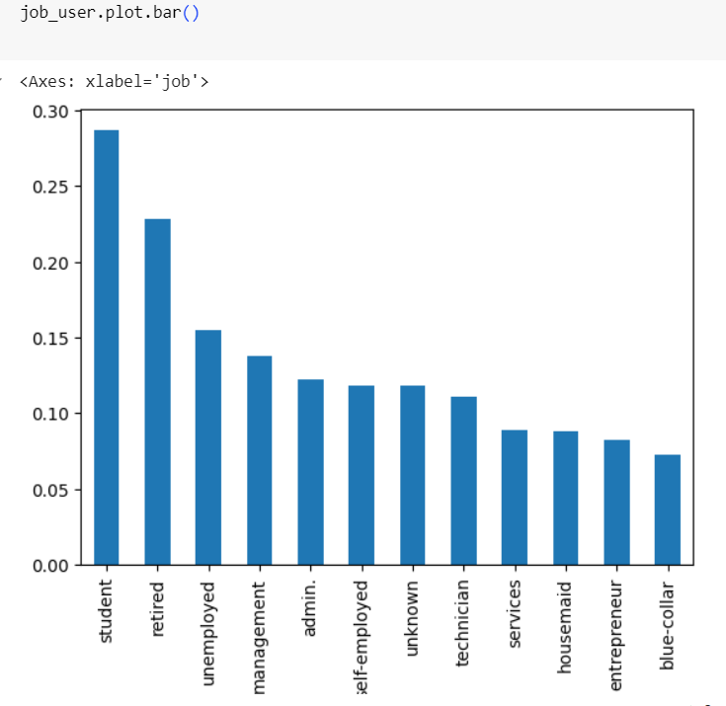
EXPLORING FEATURES:
AGE
JOB
From the above analysis, it is clear that age has an impact on customer conversion:
Clients around age 40.8 have a lower possibility of conversion.
Clients around age 41.8 have a higher possibility of conversion
From the above graph, it is clear that students, retirees, and the unemployed have a higher chance of buying insurance.

Slide 6
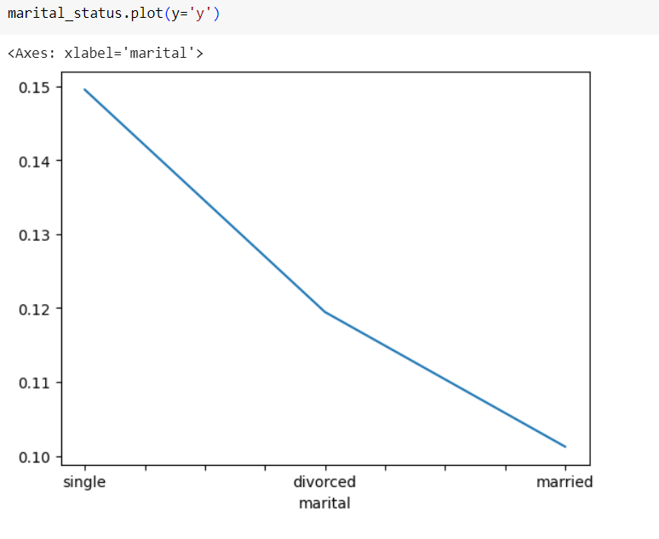
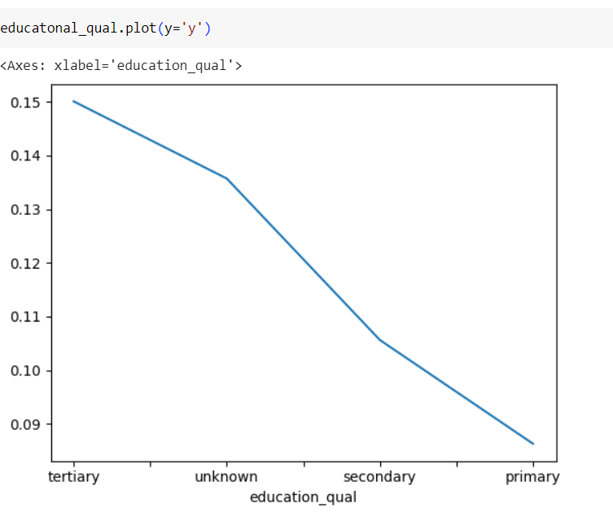
MARITAL_STATUS
EDUCATIONAL_QUAL
From above visualization it is very clear singles are more likely to buy insurance
From the above plot, it is clear that people with tertiary education have a higher possibility of buying insurance.

Slide 7
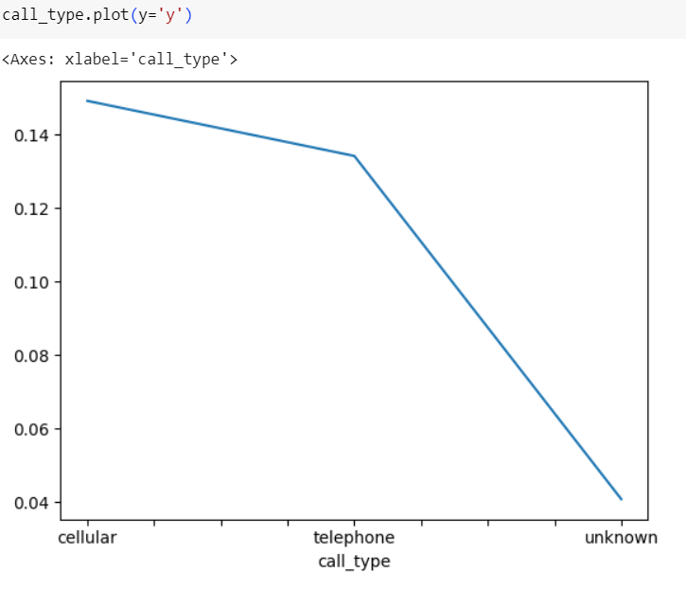
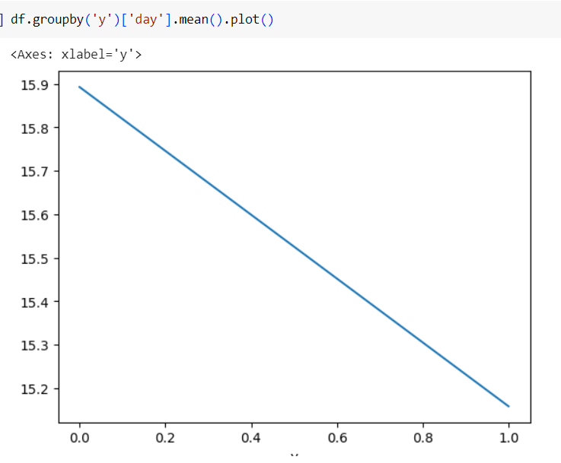
CALL_TYPE
DAY
From the above plot, it is clear that people with tertiary education have a higher possibility of buying insurance.
From the above graph, it is clear that there is a higher possibility of buying insurance at the start of the month.

Slide 8
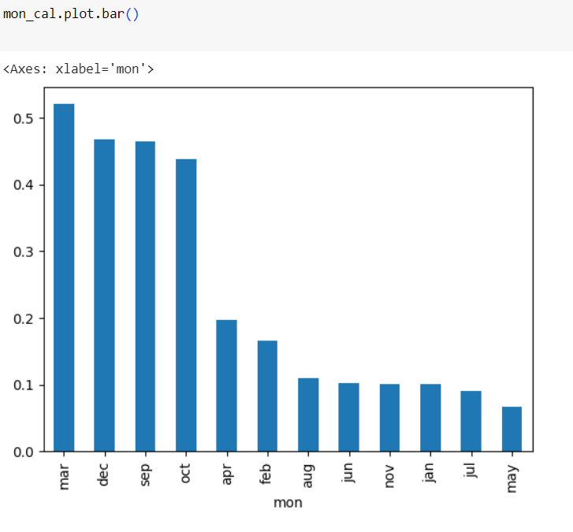
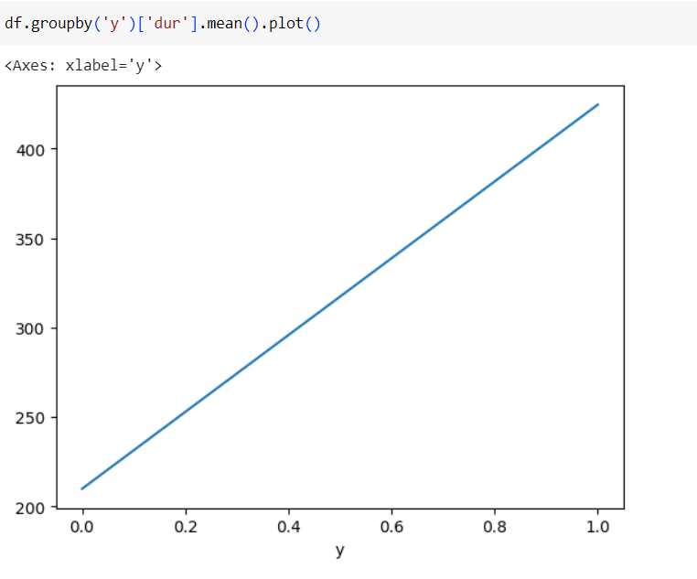
MON
DUR
From the above plot, it is evident that there is a positive correlation between call duration and the likelihood of people buying insurance. Specifically, higher call durations are associated with a higher probability of customers purchasing insurance. This suggests that longer conversations during marketing calls may lead to more successful conversions.
From the above bar graph, we can clearly see that during the months of March, December, and September, people are more likely to buy insurance.

Slide 9
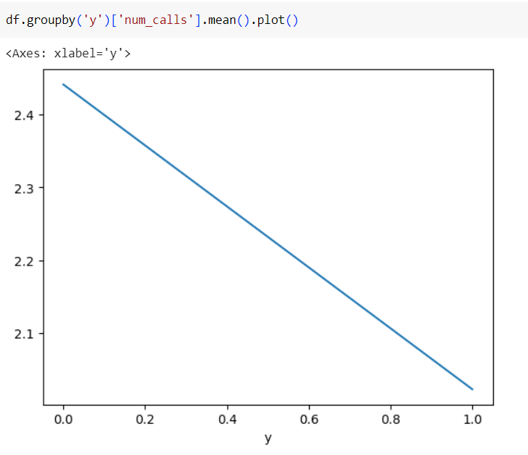
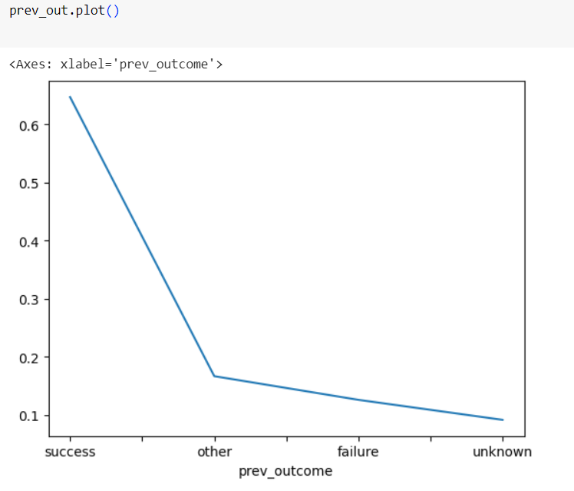
NUM_CALLS
PREV_OUTCOME
From the plot, it is clear less number of call likely to buy insurance
From above graph, it is clear that if prev_outcome more likely to get insurance

Slide 10
MACHINE LEARNING MODELS:
Models | Accuracy | F1-score(After Tunning)
Logistic Regression | 0.749585222873576 | 0.8379152348224513
Decision Tree Classifier | 0.8339785421966597 | 0.8996996996996997
Random Forest | 0.6969361796261475 | 0.7956443914081145
XGB Classifier | 0.8534454153301626 | 0.9117666644469602
From above table, it is very clear that XGB Classifier works well for this problem statement

Slide 11
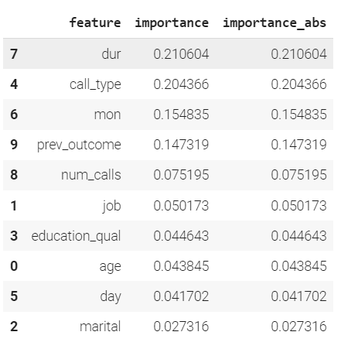
Feature Importance for Best Model:

Slide 12
CONCLUSION
In conclusion, a new-age insurance company aims to optimize its telephonic marketing campaigns by identifying customers who are most likely to subscribe to term insurance. By analyzing historical marketing data and leveraging machine learning models, the company can make data-driven decisions to target potential clients more effectively.
The dataset consists of 11 columns, including 10 features and 1 target variable, each providing valuable insights into customer behavior and characteristics.
Through the use of various machine learning models such as Logistic Regression, Decision Trees, Random Forests, Gradient Boosting, the company can predict the likelihood of a client subscribing to the insurance.
These predictions will enable the company to focus its marketing efforts on high-probability customers, thereby reducing costs and increasing conversion rates.
Implementing this predictive model will not only enhance the efficiency of marketing campaigns but also improve customer satisfaction by providing personalized outreach.
Ultimately, this approach will contribute to the company's growth and success in a competitive market.

